Slide 1
The Making of
Micromouse
ENGINEERING WORKSHOP
SEM-3

Slide 2
TEAM
PHANI KRISHNA K S S S
KAMBHAMPATI GANESH PAVAN KUMAR
GALLA VINOD KUMAR NAIDU
KASHYAP KOMPELLA

Slide 3
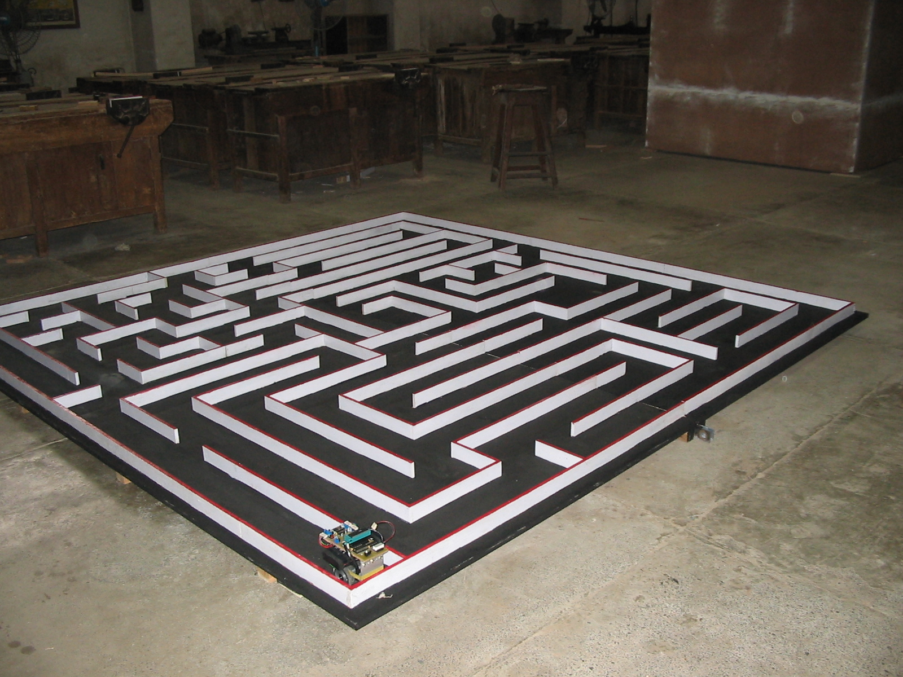
The Problem

Slide 4
Components
Microcontroller
Motor
Sensors
PCB
Battery
Chassis
Software

Slide 5
Microcontroller
ATMEL 89C52
  Cheap & easy to use
  8KB of EEPROM and 256B of internal RAM
  64KB of external RAM
Configuration
  Port 0 and Port 2 to interface external RAM of 32K
  Port 1 to drive both motors (4 coils each)‏
  Port 3 for sensor control

Slide 6
Motor
Choices
  DC Motor
    High torque
    Low Power Consumption
    Smaller size and lighter
    Cheaper
    Complex speed control
    Difficult to achieve accurate movement
  Stepper Motor
    High holding torque
    High Power Consumption
    Bulky
    Costlier
    Easy to achieve accurate movement

Slide 7
Problem with Stepper Motor
Limited choice available in market
Data sheet and specification not easily available
Difficult to judge suitability for micromouse

Slide 8
Sensors
Choices
  Ultrasonic
  InfraRed
  Mechanical Sensor
InfraRed
  Need for modulation
  TSOP – IR Receiver and filter package

Slide 9
Sensing Strategies
Sideways and front looking distance measurement
Sideways and front looking wall presence measurement
Down looking wings sensors
Combination of above
Our Choice
  Sideways and front looking wall presence measurement
  Placement and no of sensors

Slide 10
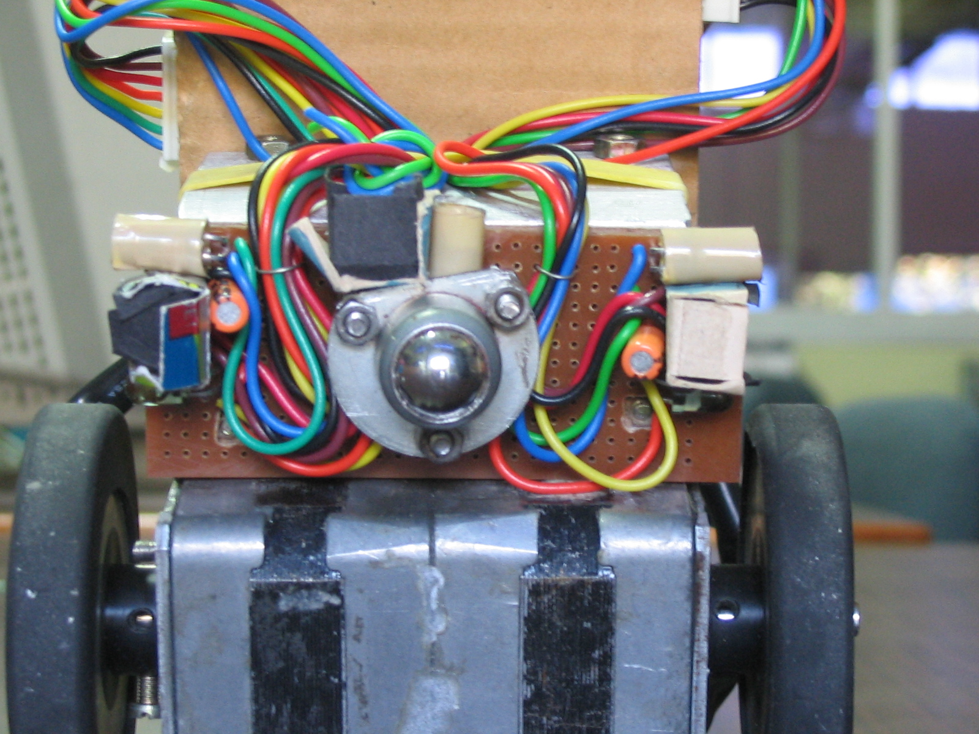
Sensor and Motor

Slide 11
Battery
Choices
  Alkaline
  NiMH – Nickel Metal Hydride
  NiCd – Nickel Cadmium
  Lead Acid
Our Choice
  Our requirement 12 V / 1.5 Amp
  Lead Acid (12V / 1.6 AmpH)‏

Slide 12
PCB
Eagle software for design
Points to consider
  VCC and GND tracks should be thicker
  Track width 0.3 mm minimum
  Distance between two tracks 0.4 mm minimum
  PCB manufacturing takes 3-4 days at least

Slide 13
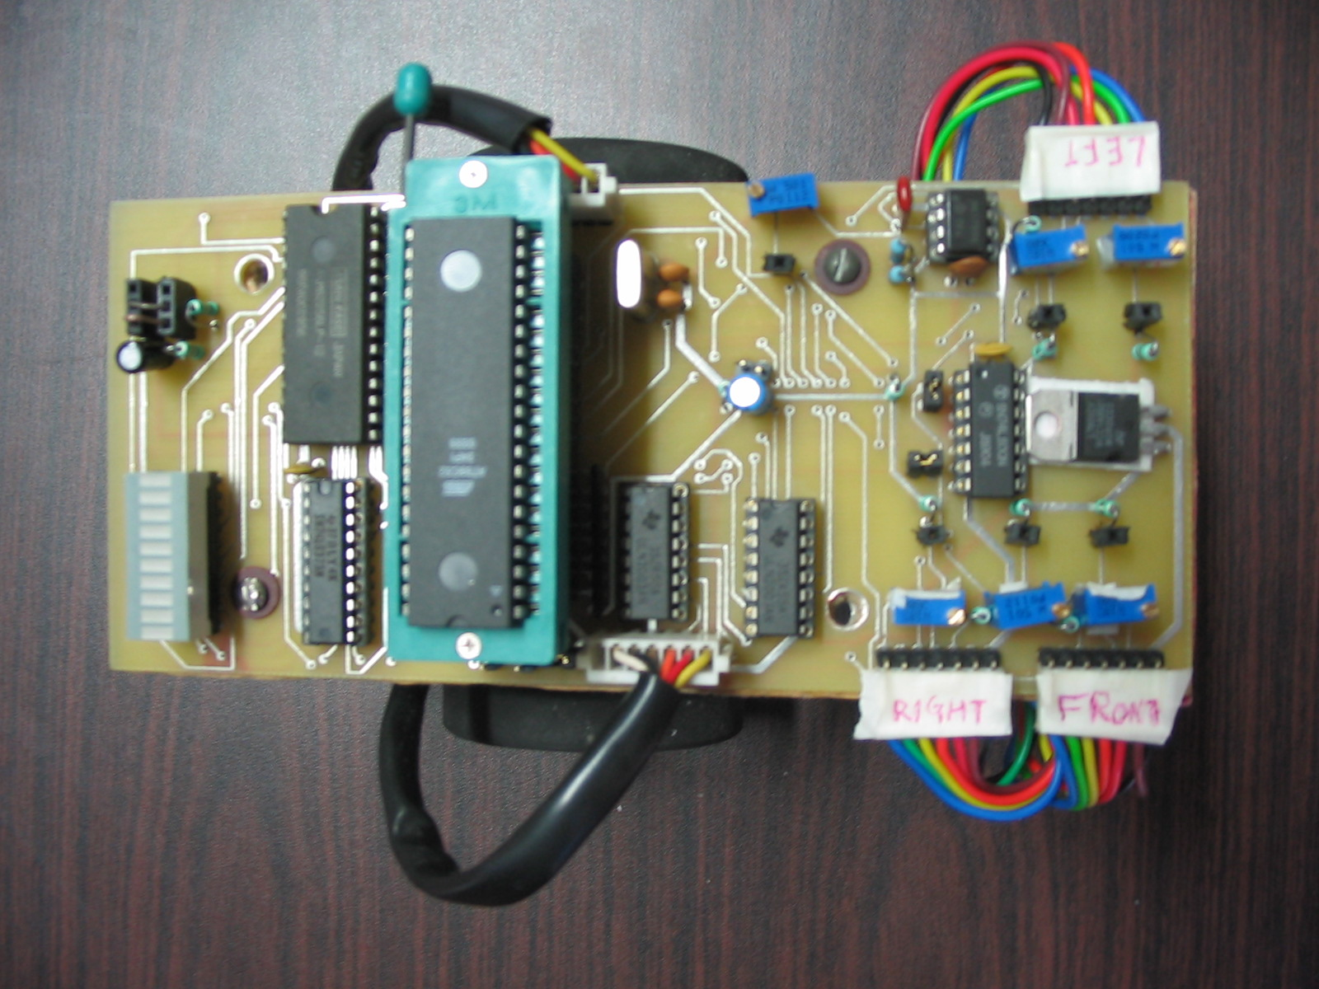
PCB

Slide 14
Chassis
Wheel Design
  4/3/2 Wheels
Our Choice
  2 wheels with castor
  Easy to achieve accurate turns
  Easy to design and make
  Ball castor
Points to consider
  Center of gravity as low as possible.
  Moment of inertia as small as possible
  Balance of weight on wheels and castor
  Light and Compact

Slide 15
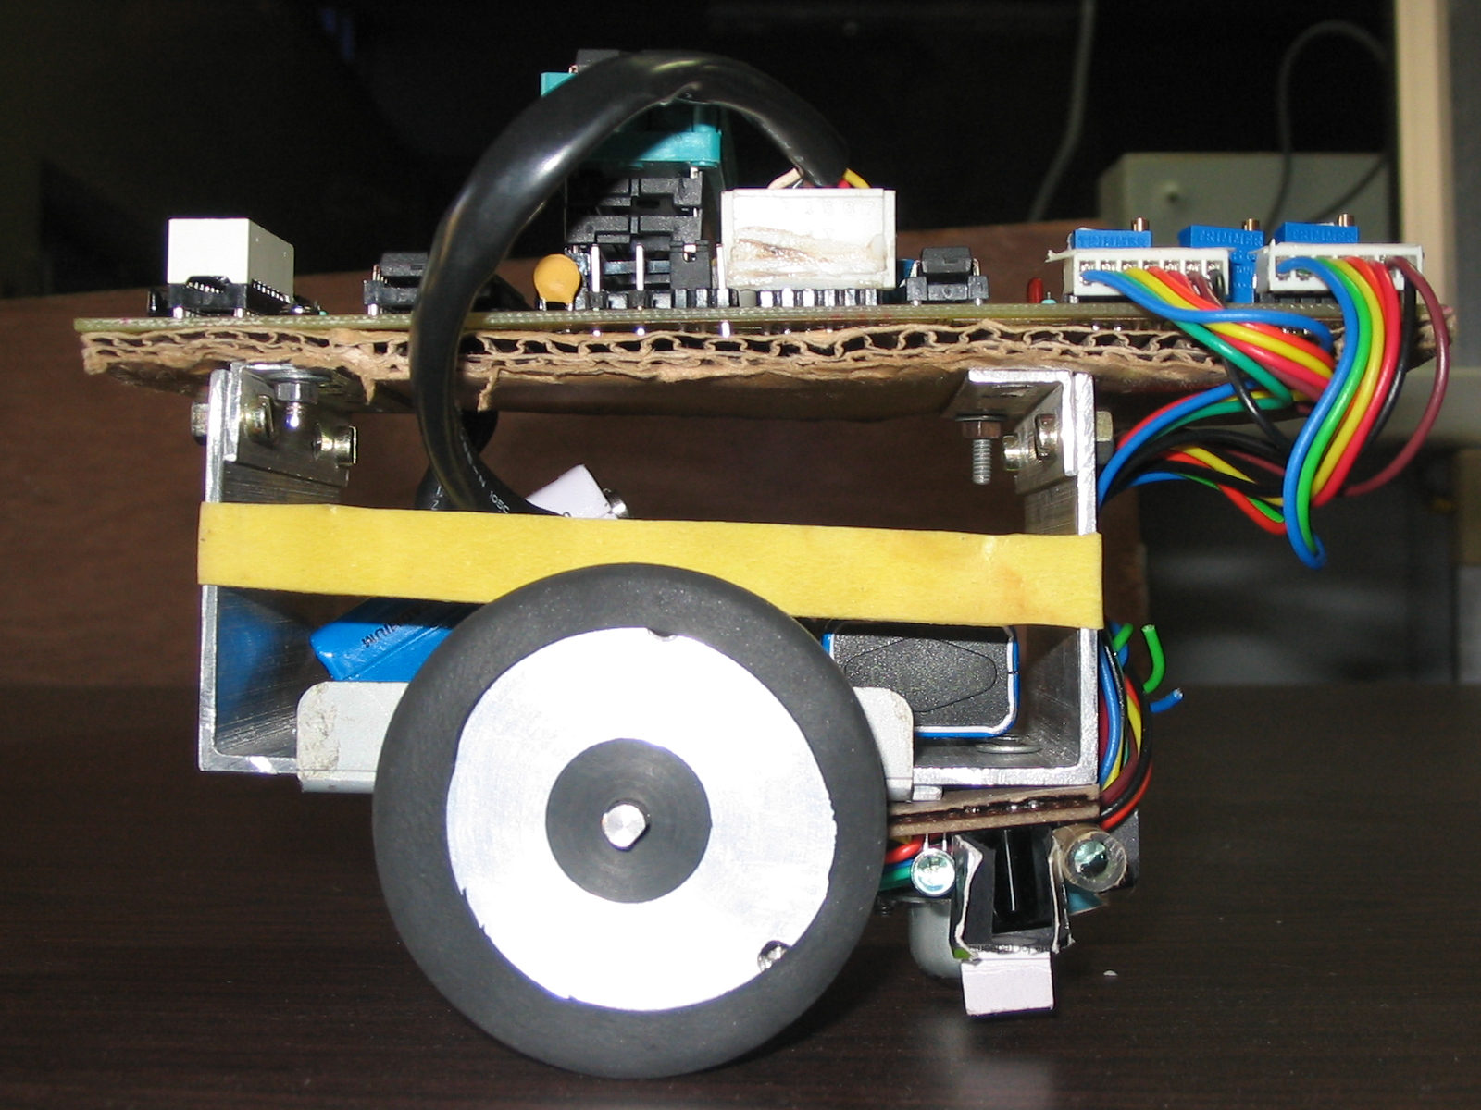
Chassis

Slide 16
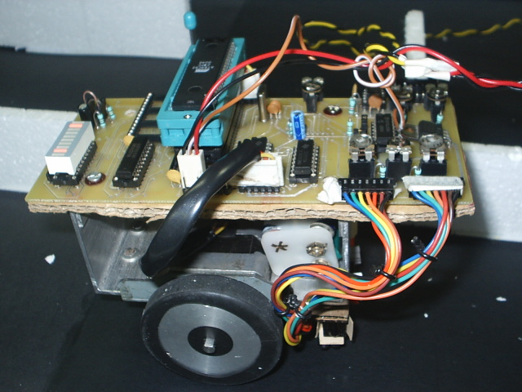
Chassis

Slide 17
Software
Written in C, compiled using Keil
Simple BFS algorithm (see simulator)‏
Features
  Guaranteed to reach the destination
  Will eventually find the shortest route
  Maintains limited history
  Avoids jerky motion during exploration
Correction Strategy
  Both side walls present
  One side wall present
  Wall edge detected

Slide 18
Thank You.
For more information check
  www.it.iitb.ac.in/~nirav/umouse

